Slide 1




Sales Dataset Analysis
DEEPA .G
27/05/2025
DADS & APRIL 2025

Slide 2





Project Overview
The main goal of this project is to carefully study sales data to find patterns and trends that can help us understand how well the business is performing. By looking at past sales numbers, we can see which products are selling the most, which times of the year are best for sales, and what areas might need improvement. This analysis will help the company make better decisions, improve sales strategies, and plan for the future. In simple terms, this project helps turn sales data into useful information that the business can use to grow and succeed.

Slide 3

KEY METRICS
the key goals of the analysis, such as:
Sales trends over time.
Identify high-performing products and
sales channels.
Create a dynamic dashboard with key metrics.

Slide 4

Data Description
DATASET OVERVIEW:
The dataset contains about 9,996 rows with details of retail sales transactions. It includes columns like Order ID, Sale ID, Product Type, Order Date, Ship Mode, Sales Amount, Quantity, Discount, Profit, Customer Info, and Product Category. The data helps analyse sales trends, performance, and profitability.
Data Cleaning Process:
The data cleaning process included removing duplicate records, handling missing values, and correcting data types. Date fields were formatted properly, and negative values in sales or discounts were flagged and corrected. Data validation was used to ensure consistency, making the dataset accurate and ready for analysis and visualization.

Slide 5




Calculation and Data Analysis
1
2
3
4
Sales by channel/product type
Total sales
$2.30M
Average sales per order
$229.9
Discount rates
$1561.09
Technology | 22638.48
Furniture | 4416.174
Office Supplies | 9892.74
Grand Total | 22638.48

Slide 6
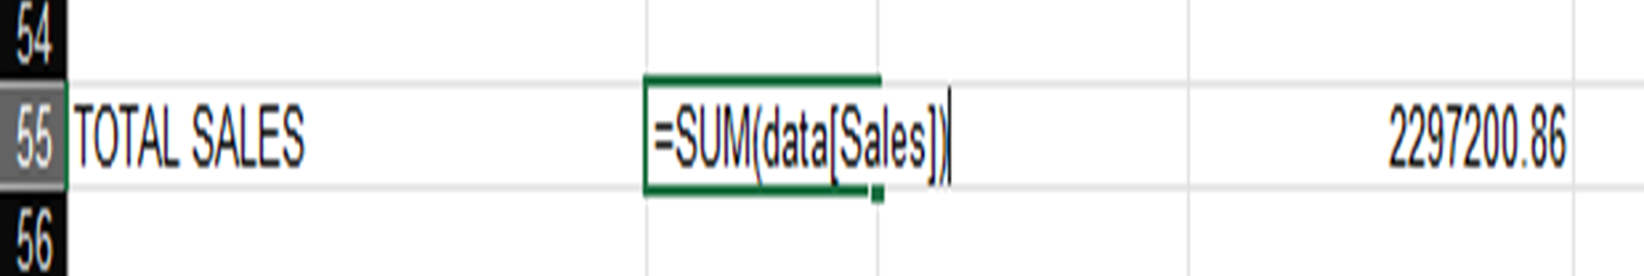
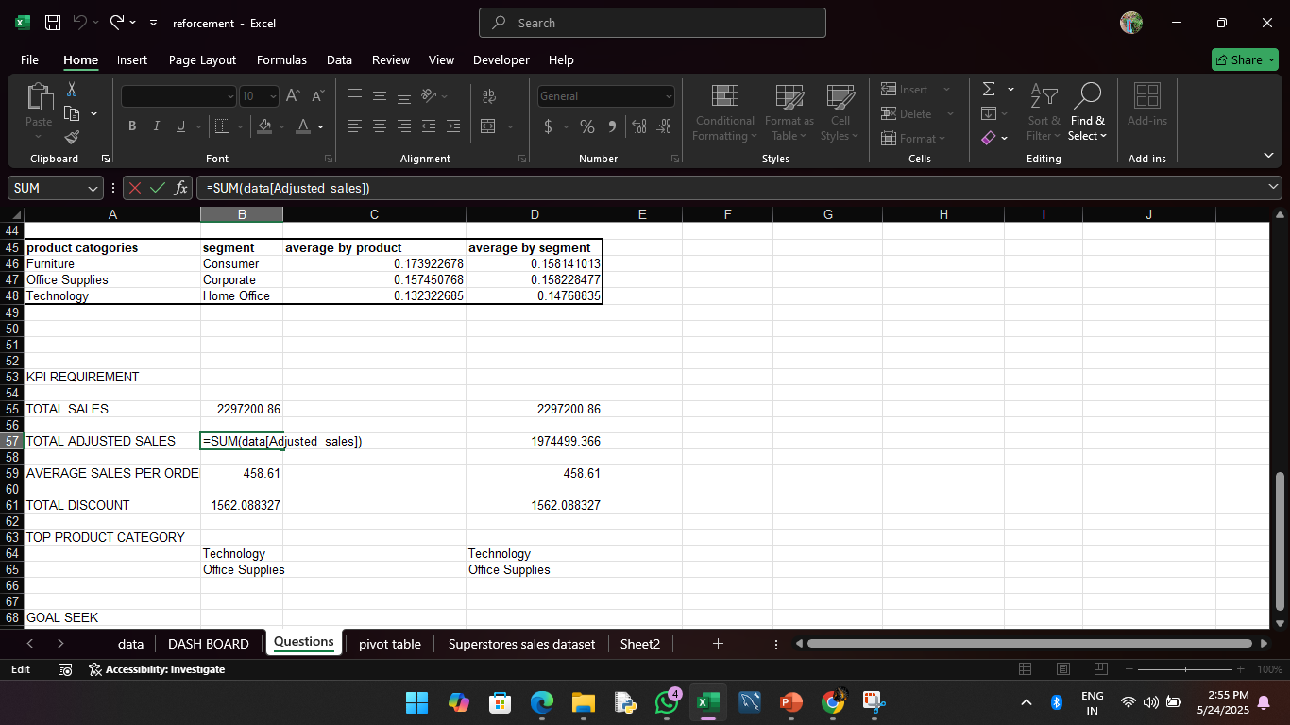
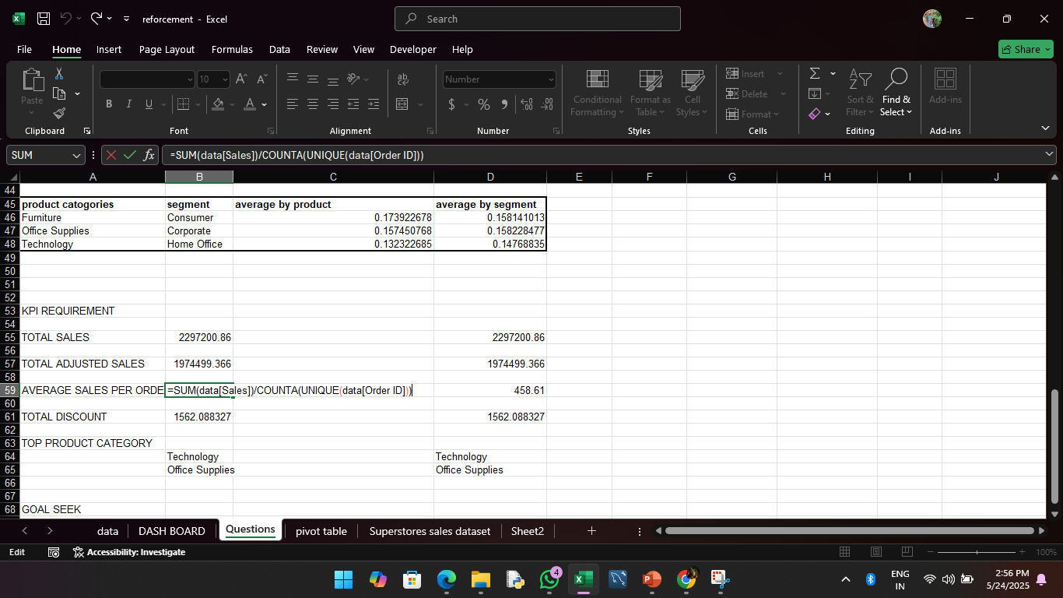
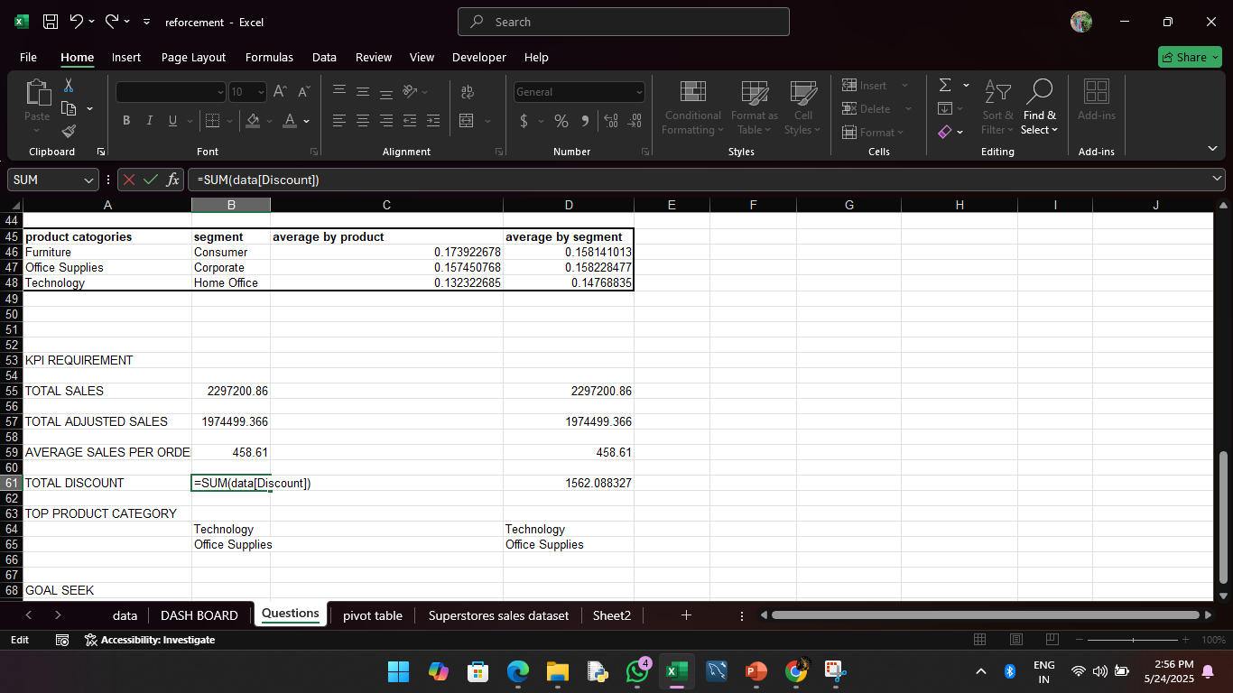
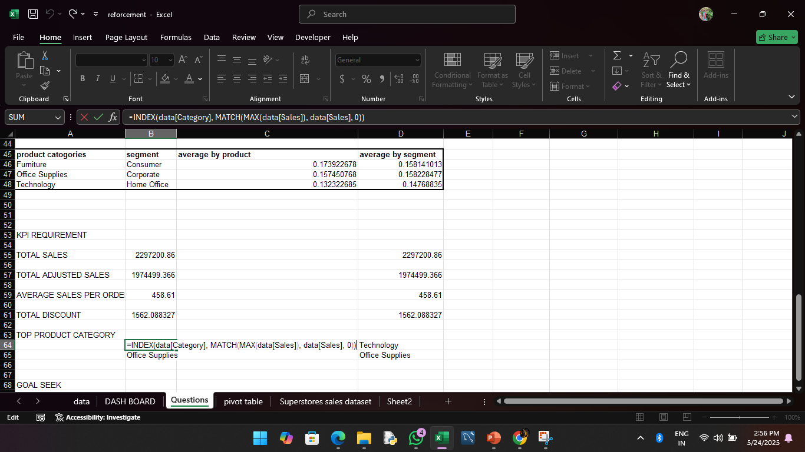

Slide 7
Pivot Tables and Pivot Charts
product category by sales
Product category | Sum of Sales
Furniture | 741999.7953
Office Supplies | 719047.032
Technology | 836154.033
Grand Total | 2297200.86

Slide 8
customer segment by sales
customer segment | Sum of Sales
Consumer | 1161401.345
Corporate | 706146.3668
Home Office | 429653.1485
Grand Total | 2297200.86

Slide 9
Ship mode by sales
ship mode | Sum of Sales
First Class | 351428.4229
Same Day | 128363.125
Second Class | 459193.5694
Standard Class | 1358215.743
Grand Total | 2297200.86

Slide 10
SALES OVER A PEROID
YEAR | Sum of Sales
2014 | 484247.4981
2015 | 470532.509
2016 | 609205.598
2017 | 733215.2552
Grand Total | 2297200.86

Slide 11

Dashboard Overview
The sales dashboard is an interactive summary tool designed to display key metrics and trends in a clear, visual format.
It includes KPI’S:
Total Sales -2297200.86
Average Order - 1974618.726
Total Discounts - 1561.09
Top-Performing Products - TECHNOLOGY
The dashboard uses Pivot Charts (bar and line charts), and interactive Slicers for filtering by Product Category, Ship Mode, and Customer Segment. These components help users quickly analyse performance, identify trends, and make informed decisions by selecting filters and viewing updates in real-time, enhancing accessibility and engagement with the sales data.

Slide 12
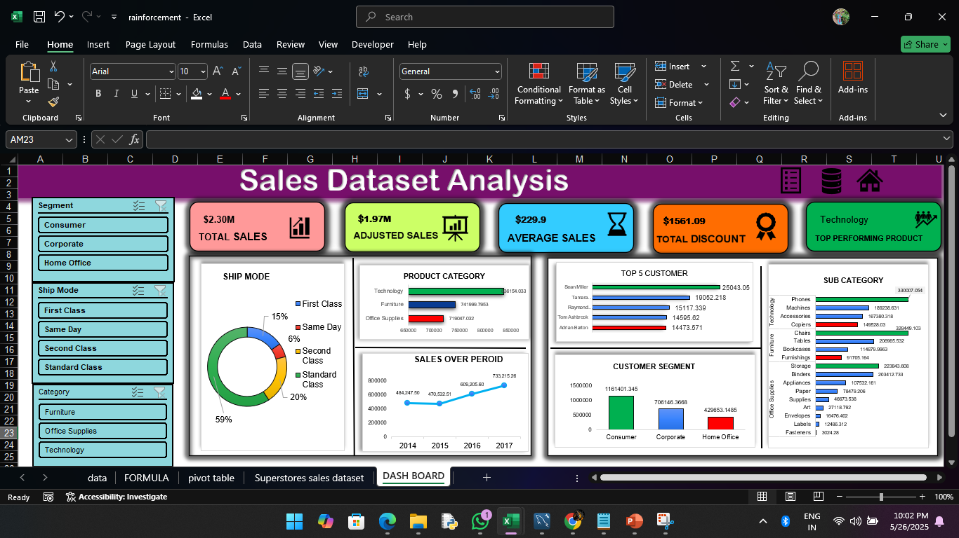

Slide 13
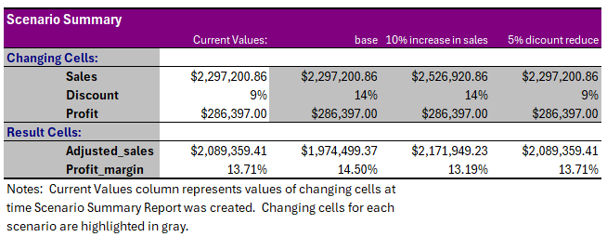
What-If Analysis
Goal Seek

Slide 14
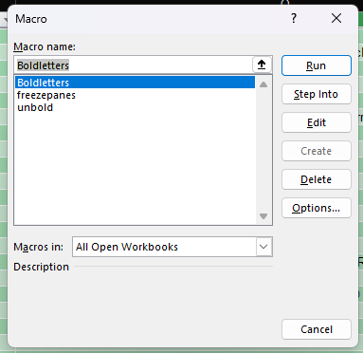
Macros and Automation

Slide 15

Insights and Recommendations
The analysis revealed that Second Class shipping generated the highest sales at ₹459193.5694, making it the top-performing sales channel.
Technology emerged as the best-selling product category with ₹836154.033 in adjusted sales.
A 5% increase in discounts led to a noticeable drop in net revenue, indicating over-discounting reduces profitability.
Sales peaked in 2017, showing strong seasonal demand. Recommendations include promoting high-performing products during peak months, reducing discounts on low-margin items, and improving marketing efforts for underperforming segments. Supporting visuals include bar charts for category-wise sales and line graphs for monthly trends.

Slide 16

Conclusion
This Excel-based sales analysis showed that total adjusted sales reached ₹1974499.366 with Technology as the best-selling category -836154.033 and Second Class as the top-performing shipping mode 836154.033. Peak sales were 2017, highlighting strong seasonal trends.
Next Steps
Use Excel’s FORECAST function to predict next quarter's sales. Apply Power Query for better data import and cleanup. Add data validation to reduce future errors. Explore customer trends by segment and region using new PivotTables. Refine dashboards with updated slicers for better interactivity.

Slide 17
THANK YOU

Slide 18
THANK YOU

